Slide 1
Lesson Two
Food contamination

Slide 2

Discuss
What groups of people are the most susceptible to food poisoning?
Notes:
What groups of people are the most susceptible to food poisoning?
Vulnerable groups include older people, the very young (babies and toddlers), pregnant women and individuals who are immunocompromised.

Slide 3
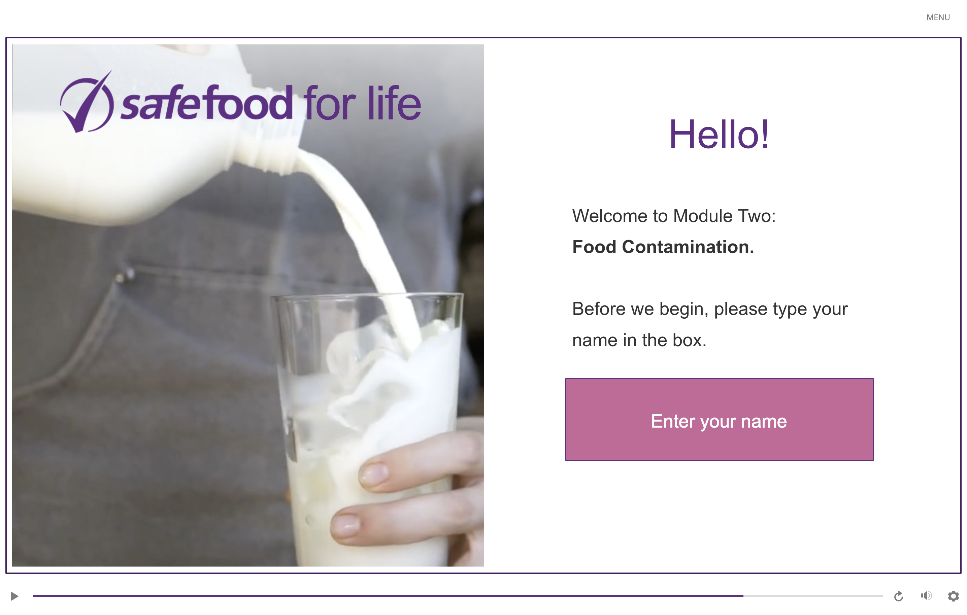
eLearning module

Slide 4
In class task
Find an example online of contamination of food with allergens.
Find an example online of chemical contamination of food.
For each of the following situations explain:
  What happened? How did the contamination happen?
  What was the outcome?
  How could it have been prevented?

Slide 5
Homework task
Either prepare a meal yourself or observe someone else preparing a meal. Watch and take note of:
  What food is being prepared
  The ways food contamination could happen. This includes any type of contamination: physical, chemical, allergen and microbial.

